Slide 1
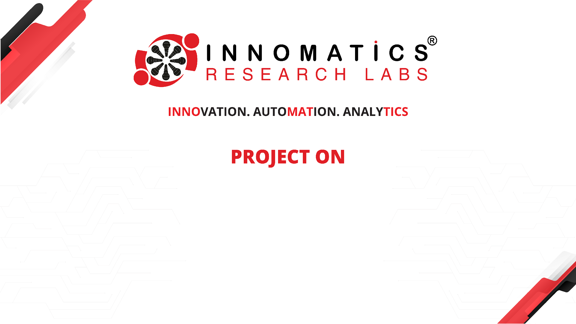
EXPLORATORY DATA ANALYSIS (EDA)
PRESENTATION BY:
RODDA AVINASH

Slide 2


ABOUT ME
I am a driven and analytical professional with a strong foundation in computer applications and data analysis, underpinned by a Master of Computer Applications (MCA) from Telangana University and a Bachelor of Science from Keshav Memorial Institute of Commerce and Sciences.
My fascination with data science stems from its transformative power to turn raw data into actionable insights that can drive decision-making and innovation. The ability to uncover patterns, predict trends, and inform strategy using data analytics not only aligns with my analytical nature but also feeds my passion for contributing to meaningful business outcomes.
My practical experience in the field of data science has been shaped by internships that allowed me to apply and expand my analytical skills in real-world scenarios:
Data Analyst Intern at MeriSkill (12/2023 – 01/2024): This role involved collaborating on data-driven initiatives, including data collection, interpretation, and visualization, where I developed interactive dashboards and reports using Power BI.
Data Analyst Intern at Data Lumina (11/2023 – 12/2023): I conducted speech recognition and categorized unstructured datasets, applied grammatical tagging, and performed prescriptive analysis, enhancing content structure through a non-technical approach.
LinkedIn and GitHub profile URLS

Slide 3
AGENDA
BUSINESS PROBLEM AND USE CASE DOMAIN UNDERSTANDING
OBJECTIVE OF THE PROJECT
SUMMARY OF THE DATA
EXPLORATORY DATA ANALYSIS:
DATA CLEANING
DATA MANIPULATION
UNIVARIATE ANALYSIS
BIVARIATE ANALYSIS
KEY BUSINESS QUESTION
CONCLUSION EXPERIENCE/CHALLENGES

Slide 4
BUSINESS PROBLEM AND USE CASE DOMAIN UNDERSTANDING
Business Problem:
The business problem revolves around understanding the employment outcomes of engineering graduates.
Specifically, we aim to explore factors that influence salary, job titles, and job locations for these graduates.
By analyzing this dataset, we can gain insights into the dynamics of the entry-level labor market and inform strategies for career development and recruitment.
Domain Understanding:
Engineering Graduates: The dataset focuses on students with engineering disciplines, making it relevant for understanding employment trends in this field.
Employment Outcomes: We examine variables such as salary, job titles, and job locations. These outcomes are crucial for both graduates and employers.
Skills Assessment: The dataset includes standardized scores in cognitive skills, technical skills, and personality skills. These scores play a significant role in employability.
Demographic Features: Demographic variables like gender, age, and educational background provide context for understanding employment patterns.
College Tiers: The tier of the college attended by graduates can impact their employability and career prospects.
Specialization and Degree: The field of specialization and the degree pursued also influence job opportunities.

Slide 5
OBJECTIVE OF THE PROJECT
Exploratory Analysis: Understand the distribution and relationships among variables in the dataset. Explore patterns, trends, and potential outliers.
Predictive Modeling: Salary Prediction: Build a model to predict the salary of engineering graduates based on features such as skills scores, college tier, specialization, and demographics.
Job Title Prediction: Develop a model to predict job titles based on relevant features.
Job Location Prediction: Create a model to predict job locations (cities) based on candidate attributes.
Feature Importance and Insights: Identify which factors (skills, education, demographics) significantly impact employment outcomes. Provide actionable insights for graduates, recruiters, and policymakers.
Recommendations: Suggest strategies for improving employability, such as skill development, college selection, and specialization choices. Recommend targeted interventions to bridge skill gaps.
Overall, the project aims to enhance our understanding of the employment landscape for engineering graduates and contribute to informed decision-making in career planning and recruitment.

Slide 6
SUMMARY OF THE DATA
The dataset was released by Aspiring Minds from the Aspiring Mind Employment Outcome 2015 (AMEO).
The study is primarily limited only to students with engineering disciplines.
The dataset contains the employment outcomes of engineering graduates as dependent variables (Salary, Job Titles, and Job Locations) along with the standardized scores from three different areas – cognitive skills, technical skills and personality skills.
The dataset also contains demographic features.
The dataset contains around 40 independent variables and 4000 data points.
The independent variables are both continuous and categorical in nature. The dataset contains a unique identifier for each candidate
Dataset:
https://docs.google.com/spreadsheets/d/1yKll2Vg_mRRrNP_yrUaGr53y1VZMygQo/edit?usp=sharing&ouid=101183190533718048323&rtpof=true&sd=true
Summary of Data:
https://docs.google.com/document/d/1xvo6kN5Q4QG-ezZKrNwg2YMD6S_fwlmz/edit

Slide 7
DATA CLEANING STEPS
The dataset was released by Aspiring Minds from the Aspiring Mind Employment Outcome 2015 (AMEO).
Handling Missing Values
Data Type Conversion
Removing Duplicates
Outlier Detection and Treatment
Standardizing and Cleaning Text Data
Handling Inconsistent Data
DATA MANIPULATION STEPS
Adding a Tenure Column
Imputing Categorical column with mode values
Validating 10, 12 percentage, and College GPA
Checking the condition of DOL > DOJ
Imputing Numerical Columns with median values

Slide 8
UNIVARIATE ANALYSIS
The dataset was released by Aspiring Minds from the Aspiring Mind Employment Outcome 2015 (AMEO).
I have performed non-visualization analysis on numerical features, which includes checking the statistical description of these features and their five- number summary.
To better understand the distribution of each numerical feature, I have utilized KDE plots.
For most of the features it was observed that the data was not normally distributed.
The Boxplots gave an idea of the presence of a high amount of outliers.
which led to the further process of Removal of outliers.
Bar graph plots for Categorical Features were also done.
BIVARIATE ANALYSIS
Bivariate Analysis I utilized the pair plot technique to comprehend the interrelation between all the features in the dataset.
Considering Salary as one element the other attributes were taken into consideration one by one and the analysis was done.
For some cases like Gender it was observed that the gender attribute was independent of the Salary
But for some cases like Designation it was seen that Software Engineershad the highest Salary

Slide 9
KEY BUSINESS QUESTION
Times of India article dated Jan 18, 2019 states that "After doing your Computer Science Engineering if you take up jobs as a Programming Analyst, Software Engineer, Hardware Engineer and Associate Engineer you can earn up to 2.5-3 lakhs as a fresh graduate.“
Based on the available data provided, it cannot be substantiated that the aforementioned assertion is true.
Is there a relationship between gender and specialization? (i.e. Does the preference of Specialisation depend on the Gender?)
Significance level:0.05So reject null hypothesis :So there is a relationship between gender and specialization

Slide 10
CONCLUSION
From overall exploratory data analysis I have extracted a few important insights:
Majority of the students completed their 10th and 12th in CBSE board.
Most of them are living in Banglore for their jobsMajority of the students are working as Software engineers.
Majority of the students are belonging to B.Tech and B.E background.
Male's are getting more average salary than female's.
Majority of the student's are from the domain of Electronics and communication.
On average all students are good in Quant, English and Logical.
Most of the student's are facing difficulty in computer programming.
Tier2 college students are getting more job oppurtunities.
The student's from Tier1 college are having more average salary than the tier2 college student's.

Slide 11
EXPERIENCE/CHALLENGES WORKING ON EDA PROJECT
I have learned a great deal from this Exploratory Data Analysis (EDA) project.
Specifically, I have acquired skills in analyzing data and applying statistical concepts to gain understanding.
Additionally, I have developed the ability to handle large amounts of data and extract valuable insights from it.

Slide 12

THANK YOU

